Slide 1
The Emergence of Symbolic Cognition from Sensory-Motor Dynamics
Randall C. O’Reilly
University of Colorado Boulder
eCortex, Inc

Slide 2
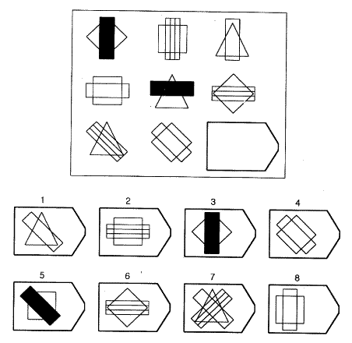
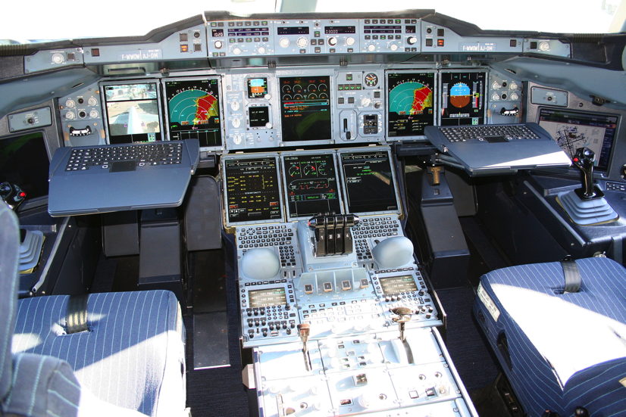
Cognitively: What is Vision For?
Vision is active, goal-driven, requires iterative, flexible parsing of complex visual scenes
Raven’s progressive matricies: test of general intelligence – depends on dynamic vision

Slide 3
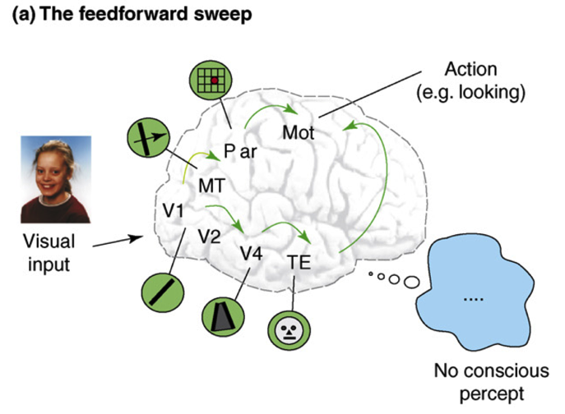
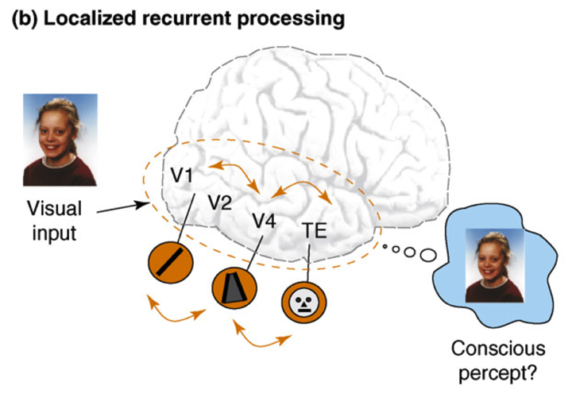
Recurrent Processing -> Consciousness (Lamme, 2006)
Consciousness is Unitary
Recurrence coordinates all areas on one thing (emerges via popular vote)
Consciousness is Functional
Helps organize, prioritize behavior – “focusing” key for difficult problems
Consciousness Flows
Temporal dynamics and information processing (multi-step cognition)

Slide 4
Attention and Consciousness
Recurrent dynamics / consciousness supports goal-driven top-down interaction with bottom-up visual processing.
Goal: Capture this process in a computational model, based on biological details of the cortex (and thalamus) to better understand exactly what is going on..

Slide 5
Bidirectional Constraint Satisfaction Word Superiority Effect: McClelland & Rumelhart, 1981

Slide 6
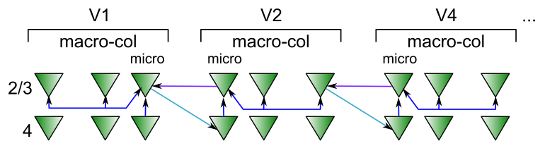
Superficial Attractor / Constraint Satisfaction Network
Computationally captured by Hopfield / (Deterministic) Boltzmann Machine models..
Except that cortical pyramidal neurons are only excitatory – need inhibitory interneurons

Slide 7
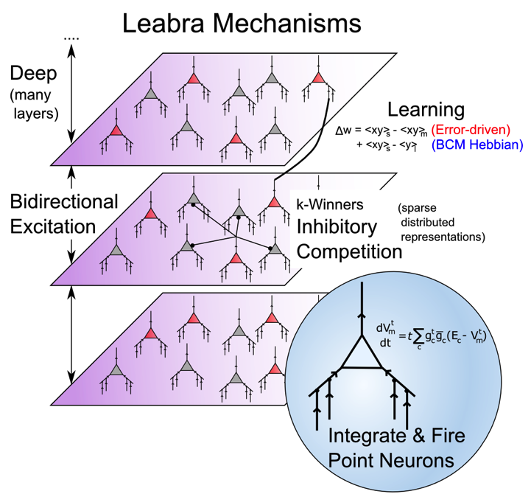
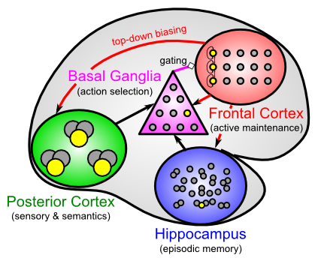
Leabra Biologically-based Cognitive Architecture
Same framework accounts for wide range of cognitive neuroscience phenomena: perception, attention, motor control and action selection, learning & memory, language, executive function – all built out of the same neurons.
http://ccnbook.colorado.edu

Slide 8
Two Parallel Networks: Thalamus & Cortex

Slide 9
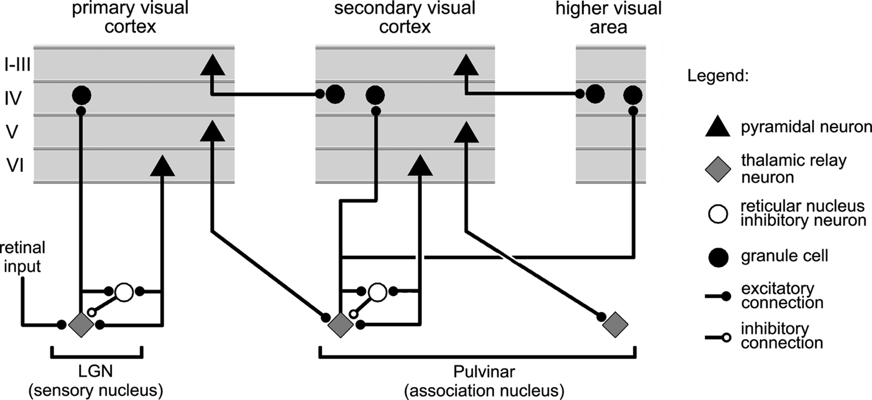
Thalamocortical Loop Biology (Sherman & Guillery, 2006)
Deep Layers drive thalamus, have strong top-down feedback effects.

Slide 10
Thalamocortical Mysteries
Why does higher-order thalamus have a few strong driver inputs, and far more weaker ones?
Why are these drivers non-plastic? How can cortex learn if thalamus does not?
What is function of the alpha rhythm (10Hz), which predominates in deep layers and thalamus?

Slide 11
Two Functions of Deep/Thal Circuit
Attentional dynamics
Deep layers particularly important for top-down
Multiplicative, normalization dynamics
Predictive learning
Context from t-1 to predict at time t (SRN)
Time updates every 100 msec (10 Hz, alpha)
Thalamic relay cells (TRC) are substrate for local auto-encoder learning

Slide 12
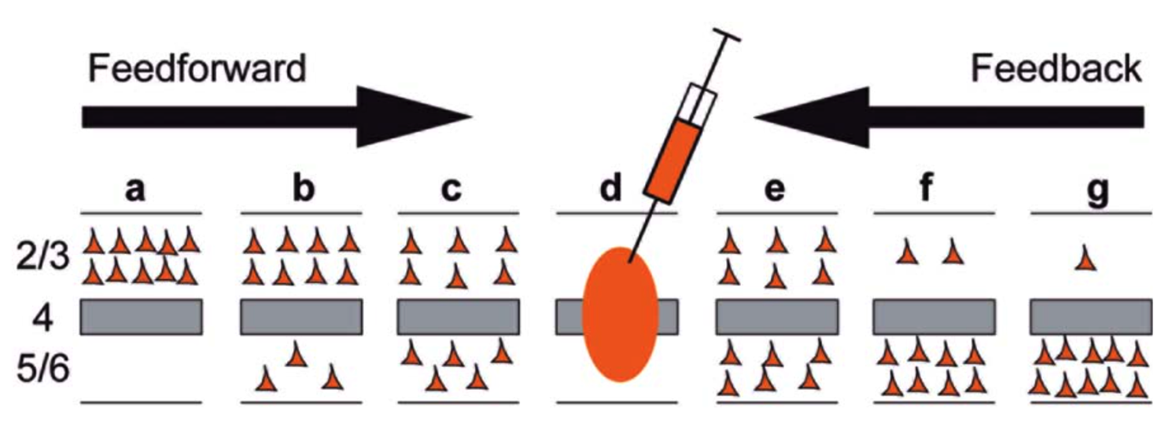
Deep Dominates Feedback
Markov et al, 2014
Feedback projections, especially those further up the hierarchy, are predominantly from deep layers – deep is particularly important for top-down attentional processing..

Slide 13
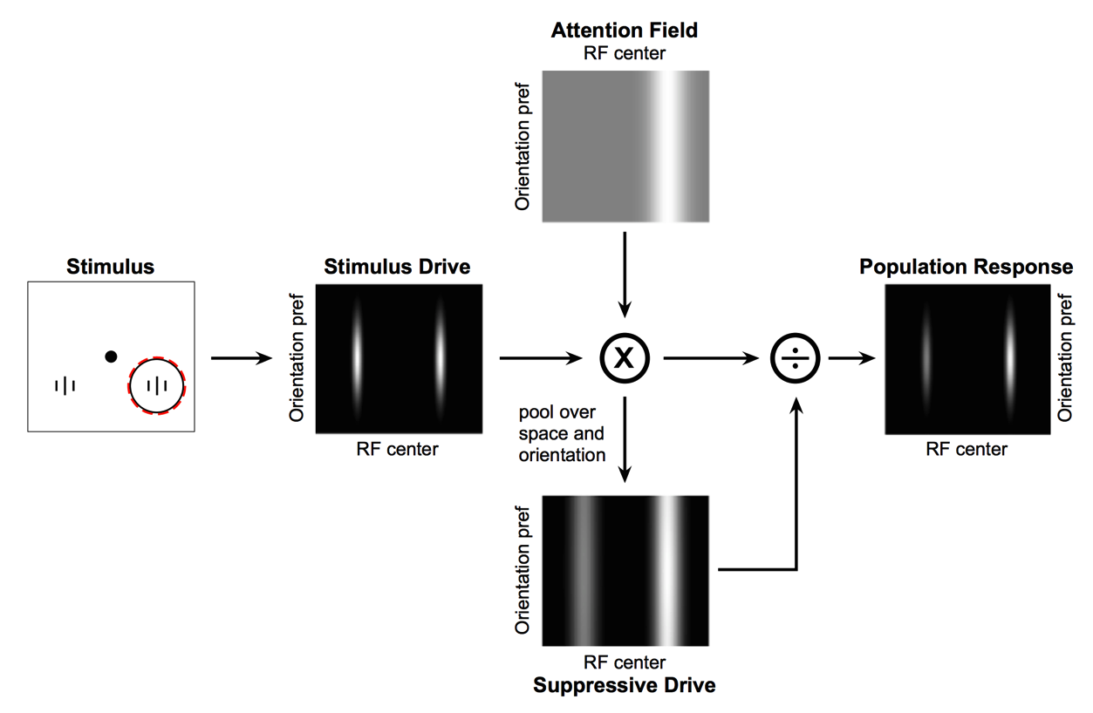
Deep Attentional Dynamics (Reynolds & Heeger, 2009; Grossberg, 1999)
Top-down deep layer
Attentional drive
Inputs to Layer 4
Layer 6 gain control
(Olsen, Bortone et al)

Slide 14
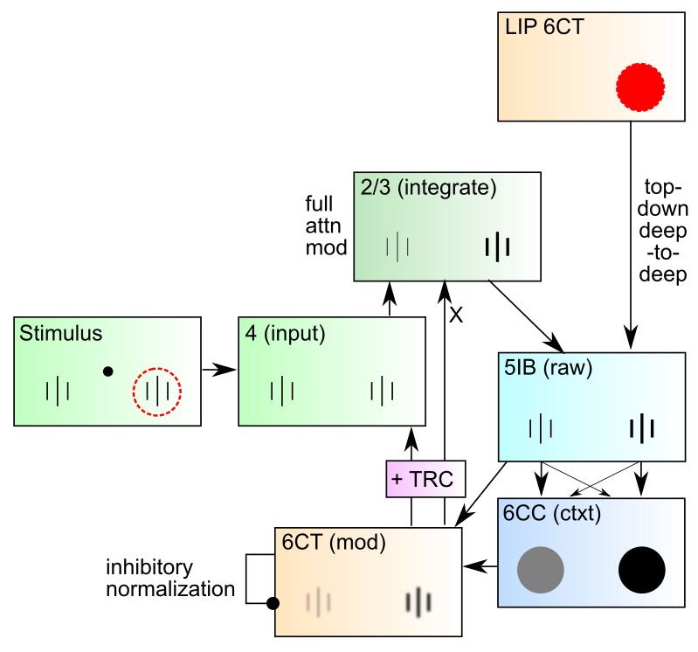
DeepLeabra Attentional Dynamics

Slide 15
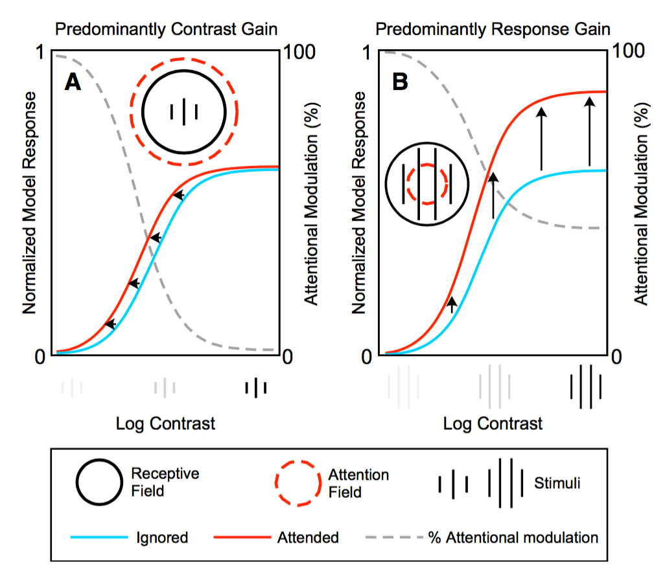
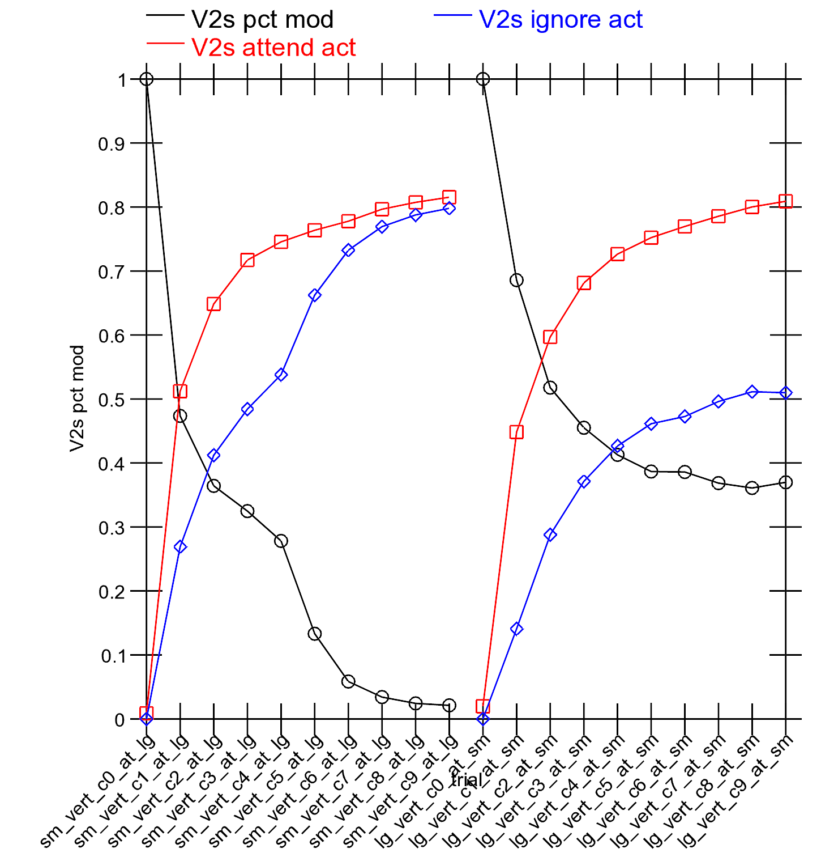
Attentional Dynamics Results

Slide 16
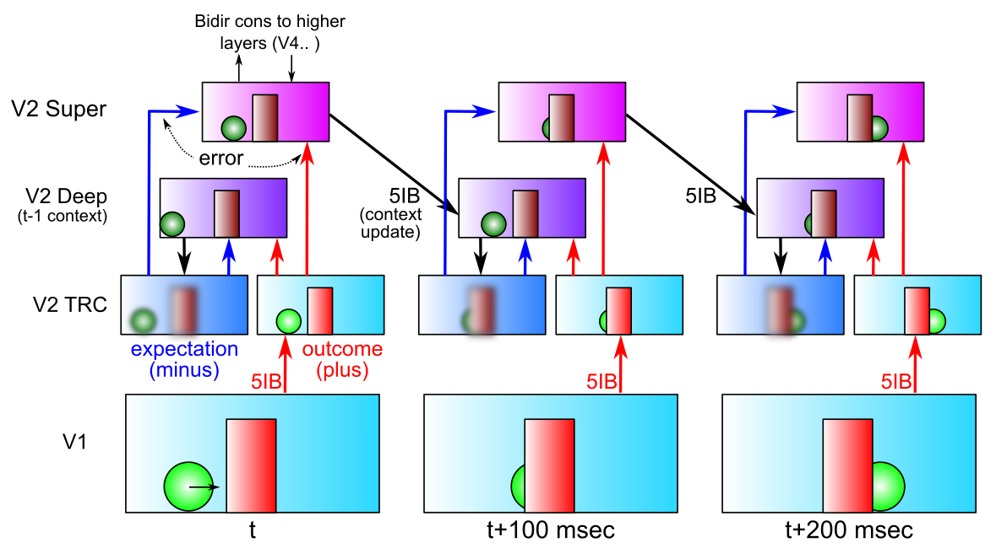
DeepLeabra Predictive Learning
Predictive learning creates nearly infinite supply of challenging learning problems: can learn a lot about physics and visual structure
Widely exploited idea: Helmholtz, Elman, Hawkins…
Requires encoding of prior context for future prediction (SRN)

Slide 17
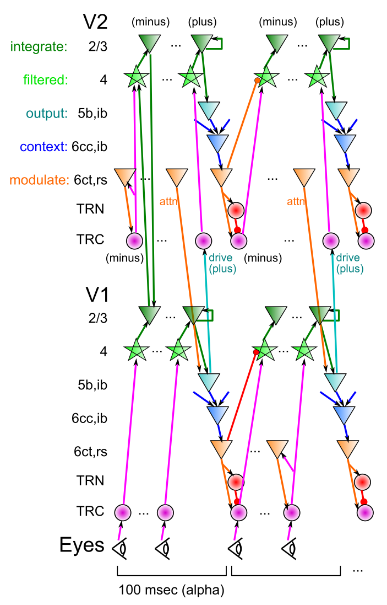
DeepLeabra
Deep neocortical layers drive multiplicative attentional modulation, through direct and thalamically mediated connections.
Alpha cycle (100msec) provides frame rate for updating of attentional mask, determined by 5ib bursting
EM-like dynamics where superficial network settles within fixed attentional mask, then attn mask is updated..
5ib also drives feedforward TRC prjn: plus phase clamp of TRC-based autoencoder (local learning signals)
6cc context provides SRN-like temporal context information for predictive learning

Slide 18
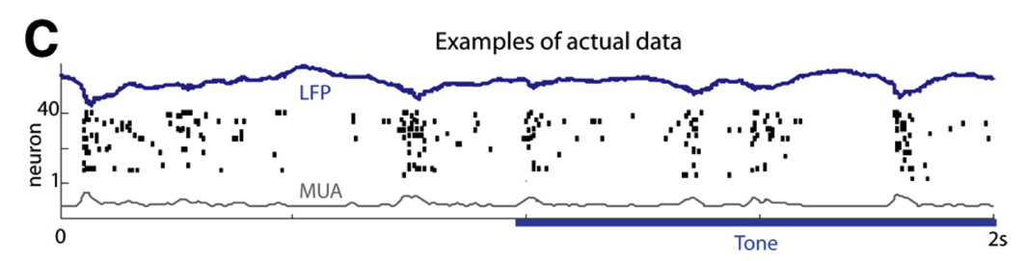
Deep Alpha: Key Biological Data
Alpha freq dominant in deep layers (e.g., Buffalo et al, 2011).
Sustained auditory tones discretized into alpha “packets” (Luczak et al, 2013)
Many indications of discretization in perception (Van Rullen & Koch, 2003)
Predictive coding during saccades
Deep5b alpha bursting to a continuous auditory tone (Luczak et al, 2013):

Slide 19
Thalamocortical Mysteries
Why does higher-order thalamus have a few strong driver inputs, and far more weaker ones?
Why are these drivers non-plastic? How can cortex learn if thalamus does not?
TRC as auto-encoder: FF drivers provide “plus phase” training signal, as fixed xform of input layer
What is function of the alpha rhythm (10Hz), which predominates in deep layers and thalamus?
EM outer loop, defines minus-plus learning frame

Slide 20
Development of Cortex via Predictive Learning
Elman et al: “Rethinking Innateness” – predictive learning via Elman networks
New idea: To accurately predict the visual world, high-level abstract representations are needed from the start

Slide 21
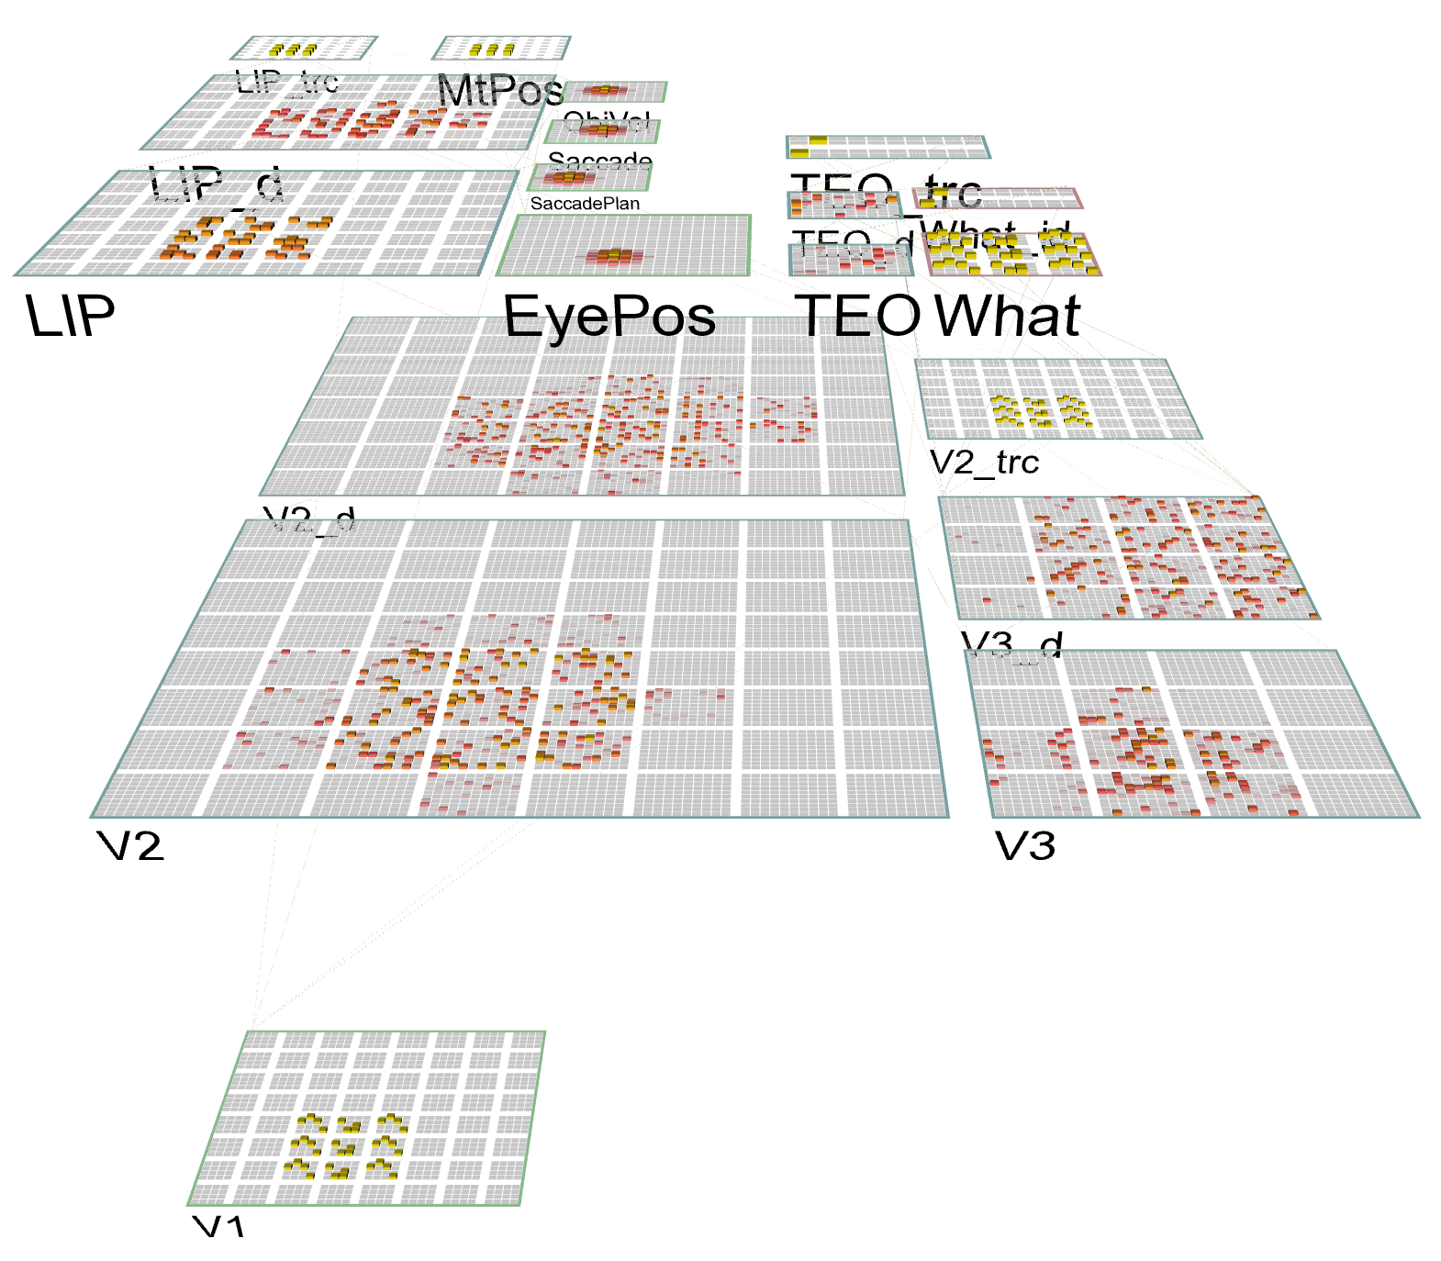
What-Where-Integration Model
MT, LIP = Dorsal ‘Where’ pathway, gets eye saccade inputs, predicts where object will move based on intrinsic motion and saccade plan
Develops first via shortcut pathway – only needs basic “spatial blob” – very simple abstraction.
TEO = Ventral ‘What’ pathway – represents object features in invariant form.
V2,V3 = Learn to integrate top-down inputs from LIP + TEO to predict visual scene in next alpha trial

Slide 22
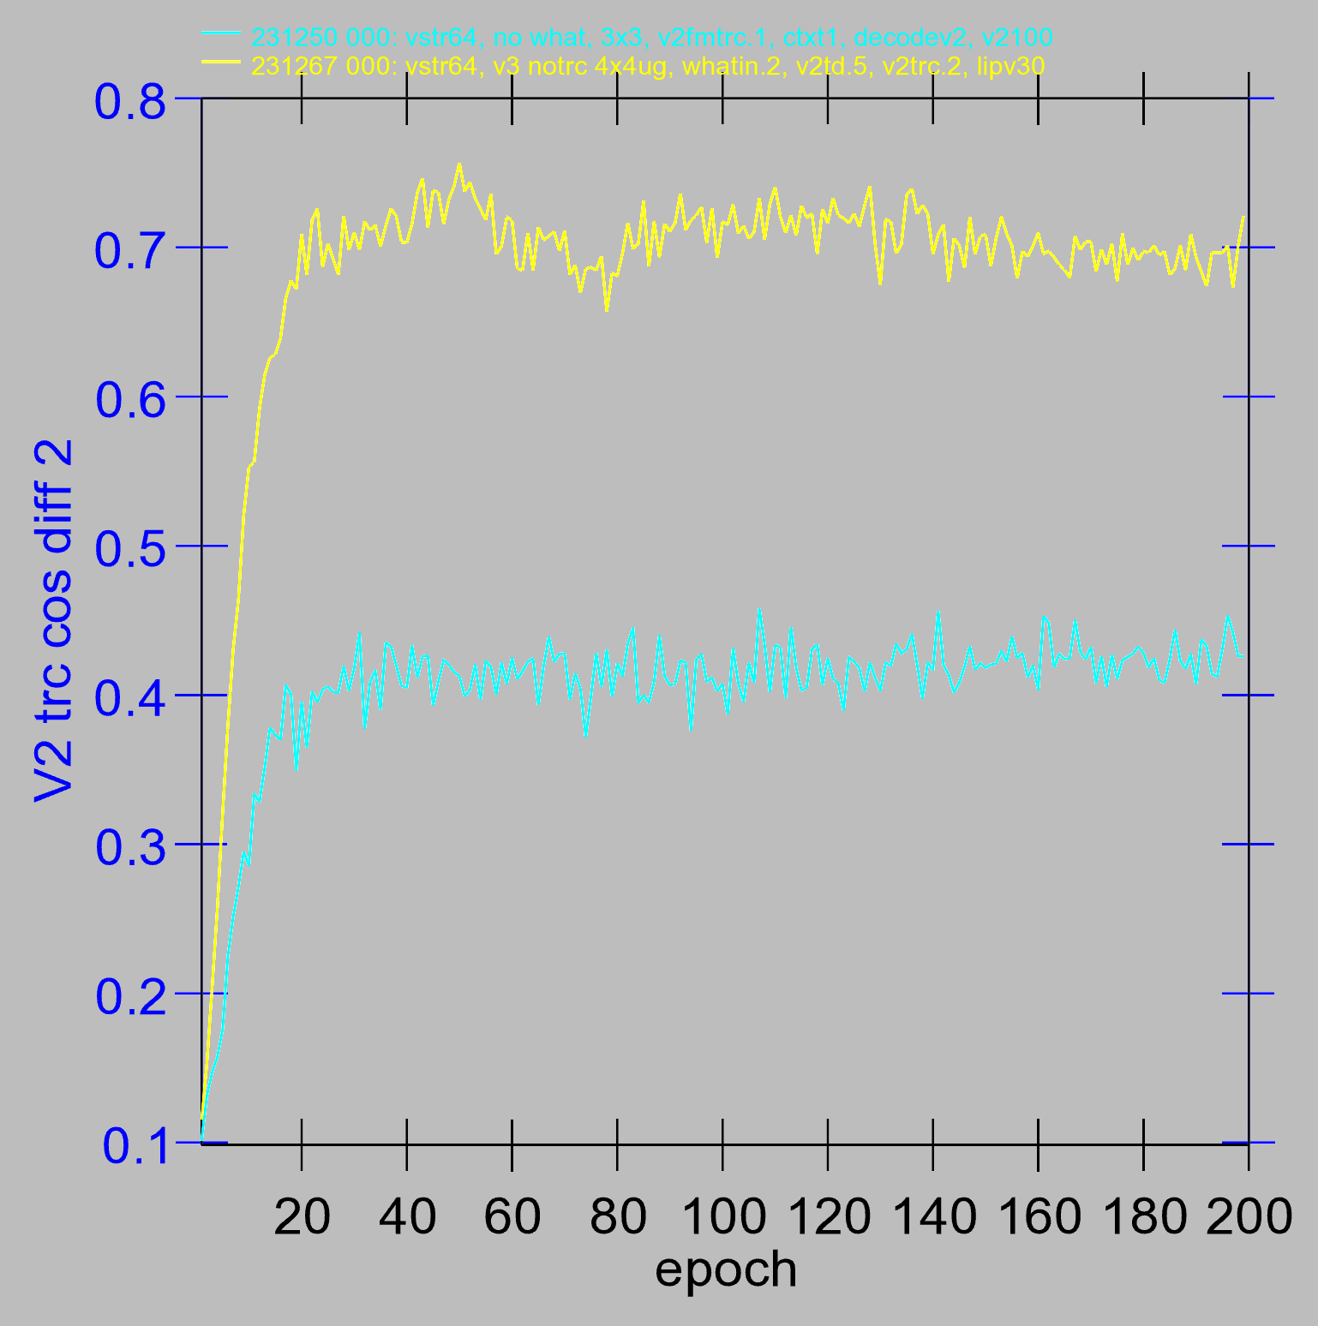
Effect of Top-down “What” reps

Slide 23
Key Results
Accurate prediction of visual world requires top-down input of high-level eye & object location and motion information
Visual angle is too large for low-level areas to compute
Short-cut connections V1 -> LIP exist!
With spatial location information in place, can learn abstract “what” pathway
Both together are essential for good prediction!

Slide 24
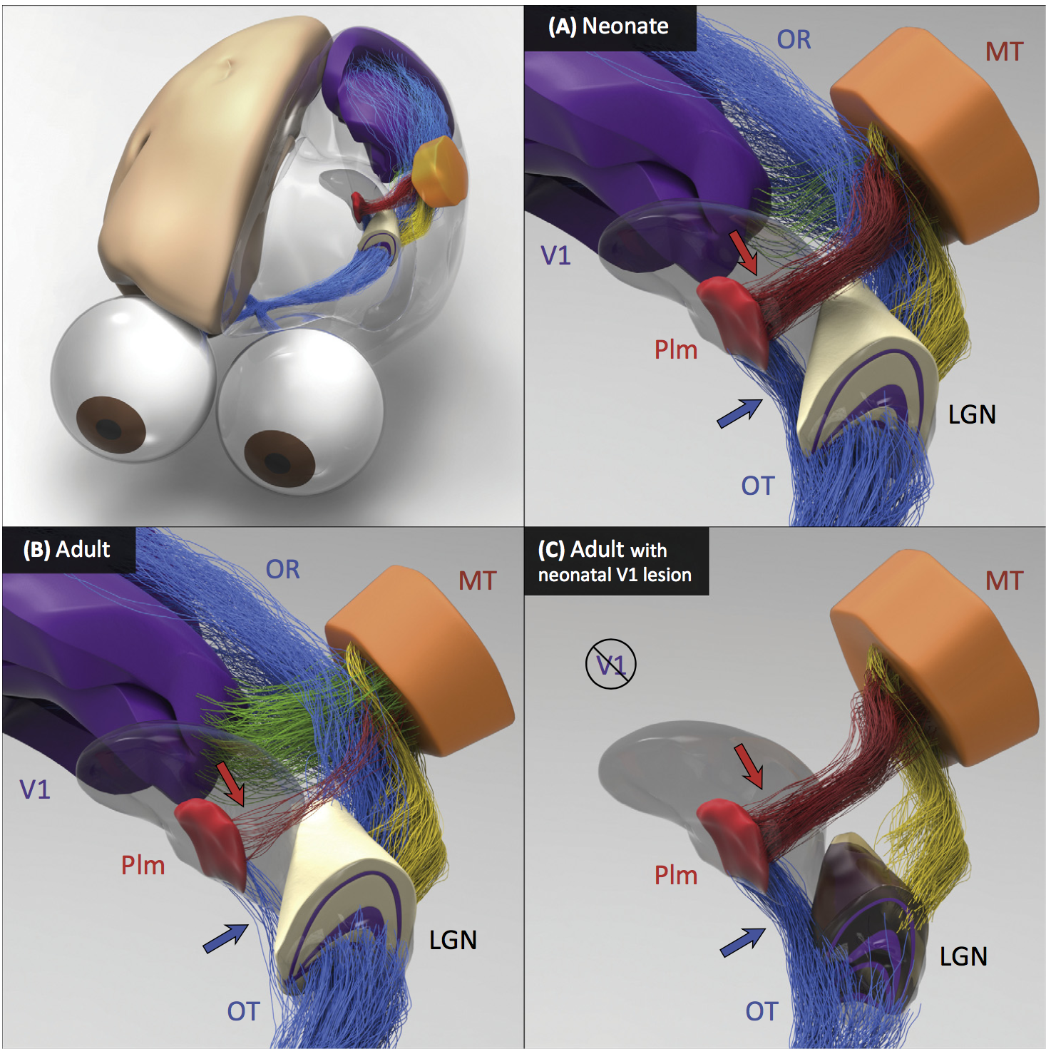
Neonate has direct shortcut connections from LGN to Pim = Pulvinar which then trains area MT as key input to the “where” visual pathway
Adult loses this retinal shortcut, has more cortical (V1, etc) drive.
This shortcut is essential for our model to learn high-level spatial representations first, to enable effective visual predictions.

Slide 25
Other Results
Deep attentional dynamics can pick out figure object against background – motion and binocular depth cues provide figure signal.
TRC predictive auto-encoder on V2, V3 produces some learning benefits.
Multimodal Mutual Learning: Auditory and visual pathways train each-other to recognize and name objects.

Slide 26
Key Prediction: Full Processing Requires 2 Alpha Cycles
First alpha cycle = bottom-up processing of new input without established prediction
Second cycle = deep-layer prediction (generative model of scene) contrasts with second wave of bottom-up processing, differences drive learning
Predictions: saccade duration = 2 alpha cycles; novel vs. familiar emerges in 2nd alpha cycle

Slide 27
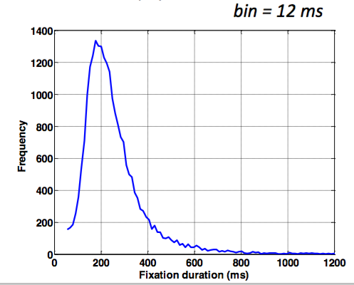

Data from David Sheinberg, Tim Curran’s labs Consistent with predictions from model
Super
Layers
(2 cyc,
nov vs
fam 2nd only)
Deep
Layers
(2nd cyc
only)
Left: super vs. deep local field potential in monkey IT cortex, showing 2 alpha-frequency waves in superficial layers, 1 in deep layers, with familiar vs. novel differences emerging in 2nd alpha cycle.
Right: fixation duration for humans in free viewing of complex scenes, with strong 200msec peak predicted by model (2 alpha cycles)

Slide 28
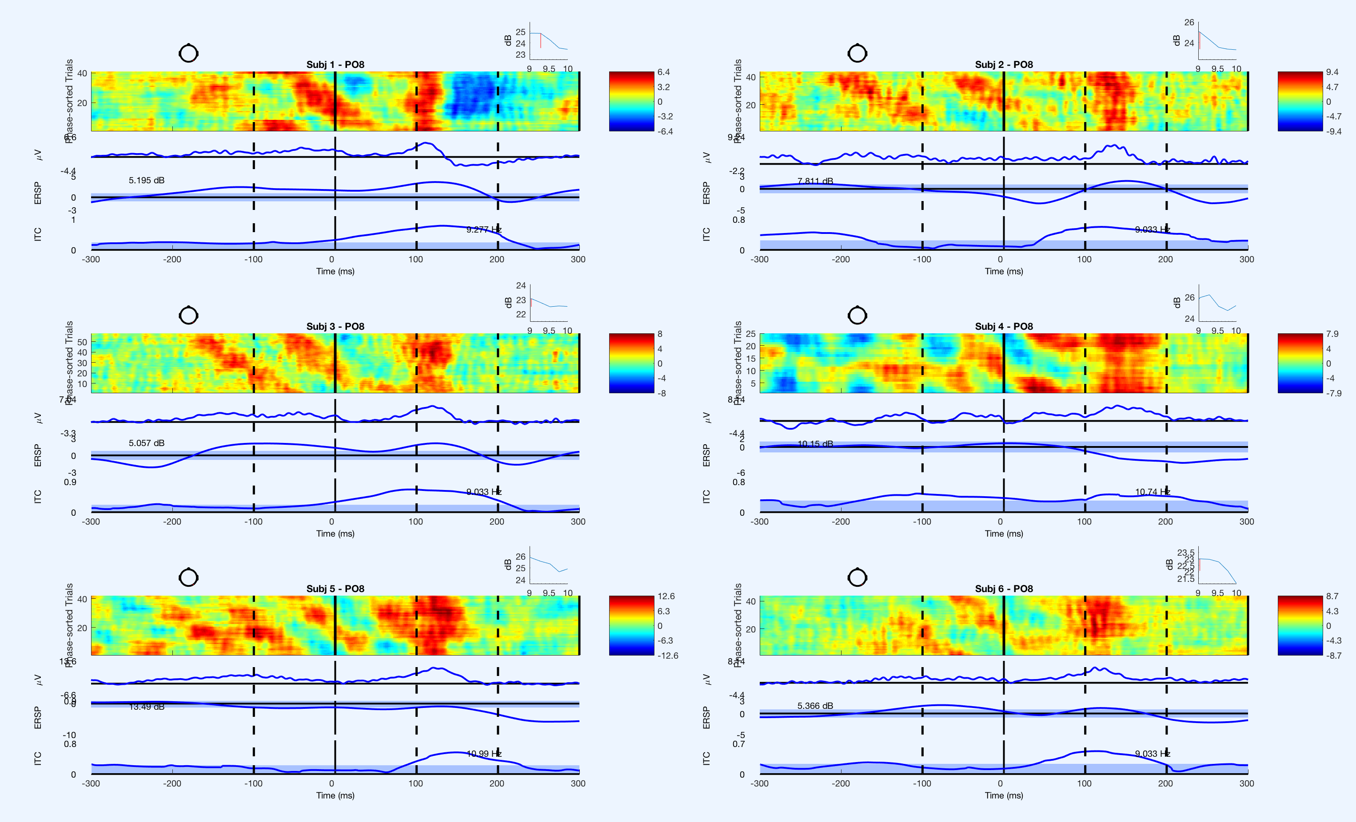
Saccade Resets Alpha (Zolfaghar, Devillez, Curran et al, in prep)
fixation onset
synchronized alpha

Slide 29
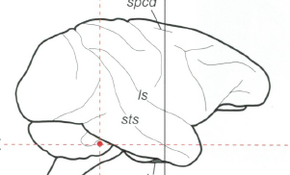
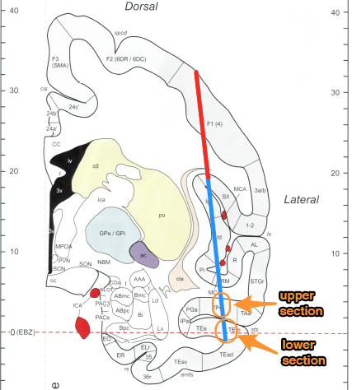
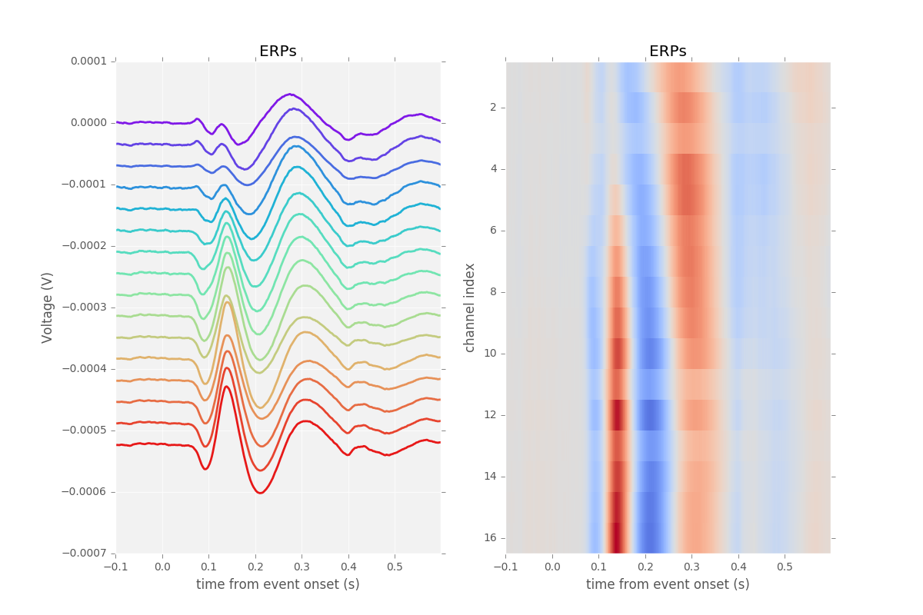
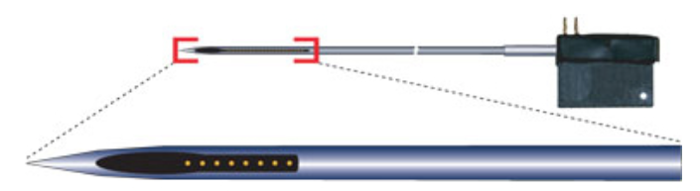
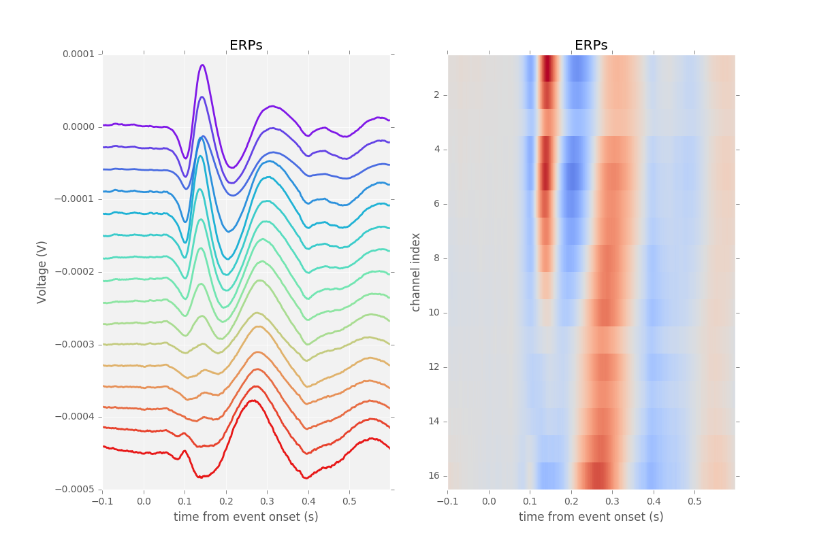
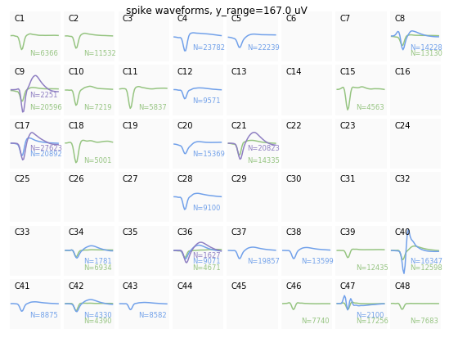
Simultaneous V4 and IT Recording (Guan & Sheinberg, in prep)
Spike waveforms

Slide 30
IT Encodes Familiarity First
Despite having slower onset, IT encodes familiarity before V4
} novel
} familiar
PSTH
significance
onset
offset

Slide 31
Summary: Two Networks in One
Recurrent dynamics / consciousness supports goal-driven top-down interaction with bottom-up:
Superficial cortical layers:
Hopfield / Boltzmann constraint satisfaction
Deep cortical layers & thalamus:
Attentional dynamics
Deep layers particularly important for top-down
Multiplicative, normalization dynamics
Predictive learning
Context from t-1 to predict at time t (SRN)
Time updates every 100 msec (10 Hz, alpha)
Thalamic relay cells (TRC) substrate for local auto-encoder learning

Slide 32
Big Picture
Higher-level cognition emerges from sensory-motor attentional dynamics
Binding multiple elements of a visual scene, understanding their relationship is foundation of many cognitive abilities: language, analogy, Raven’s task, etc..

Slide 33
Thanks To
CCN Lab
Will Chapman
Tom Hazy
Seth Herd
Kai Krueger
Jessica Mollick
Ananta Nair
John Rohrlich
Dean Wyatte
Maryam Zolfaghar
Collaborators
Tim Curran
Hellene Devillez
David Sheinberg
Shaobo Guan
Funding
ONR – Hawkins
ONR – McKenna & Bello
IARPA – ICArUS
NIMH P50-MH079485

Slide 34
Extras

